Slide 1
SIGN LANGUAGE RECOGNITION
Submitted by:-
AKASH (00311502716)
MANAN PULIYANI (35311502716)
AANCHAL MER (00111507217)
MANISHA KUMARI (00311507217)
MENTORED BY:
SHILPA GUPTA
Asst. Professor
CSE Department.

Slide 2
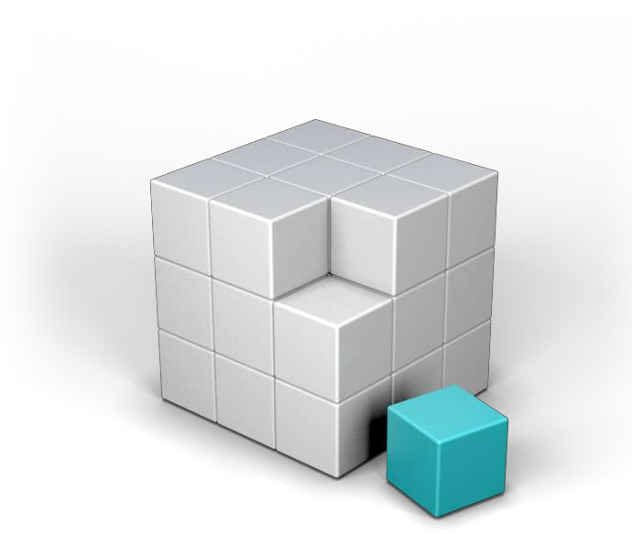
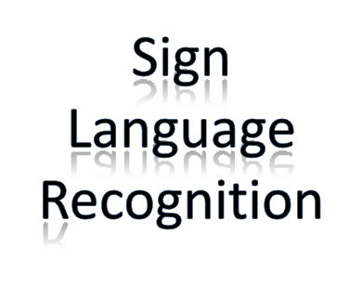
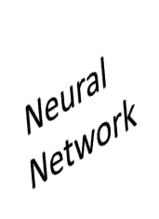
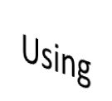
Table of content :
Sign language
Why need SLR
Helping process of SLR
Working procedure of SLR
Text to Sign Conversion
Block Diagram of SLR
Limitations

Slide 3

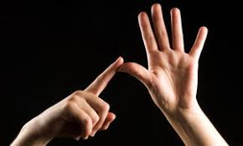
Introduction :
Gesture recognition is an open problem in the area of computer vision, a field of computer science that enables systems to emulate human vision.
Gesture recognition has many applications in improving human-computer interaction, and one of them is in the field of Sign Language Translation,
Wherein a video sequence of symbolic hand gestures is translated into natural language.

Slide 4

Problems :
About 2 million people are deaf in our world. Deprived from various social activities. Like communication.
They are under-estimated to our society
They uses different medium such as hands, face, or eyes rather than vocal tract or ears for communication purpose.

Slide 5
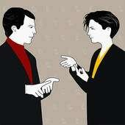
Objective :
SLR can be a desirable interpreter which can help both the community general and deaf.

Slide 6
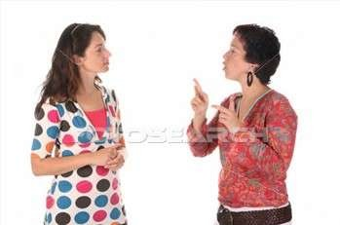
Objective :
How will it help ?
Suppose a deaf customer went to a shop. She is trying to express her demands to the shopkeeper using sign language but the shopkeeper can not understand her demands
shopkeeper
Deaf
customer

Slide 7
Literature Review of Paper :
Jie Huang [13] in the year 2018 proposed LS-HAN framework for continuous SLR is proposed, which eliminated both the error prone temporal segmentation and the sentences synthesis in post-processing steps.
For video representation, a two stream 3D CNN generates highly informative global-local features, with one stream focused on global motion information and the other on local gesture representations.
Our future work could involve the extension of the LS-HAN to longer compound sentences and real-time translation tasks.
Ching-Hua Chaun [3] in the year 2014 presented an American Sign Language recognition system using a compact and affordable 3D motion sensor.
The palm-sized Leap Motion sensor provides a much more portable and economical solution than Cyblerglove or Microsoft kinect used in existing studies. They also obtained features for fingers from the API.
For each of the five fingers, they collected its direction (a unit direction vector) and length (in millimeter).

Slide 8
Research Methodology :
Technology used :
Computer Vision
Machine Learning
Deep Learning

Slide 9
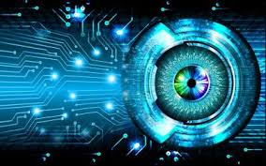
Computer Vision :
Computer vision is an interdisciplinary scientific field that deals with how computers can be made to gain high-level understanding from digital images or videos. From the perspective of engineering, it seeks to automate tasks that the human visual system can do.

Slide 10
Open CV :
OpenCV (Open source computer vision) is a library of programming functions mainly aimed at real-time computer vision. Originally developed by Intel, it was later supported by Willow Garage then Itseez (which was later acquired by Intel). The library is cross-platform and free for use under the open-source BSD license.
OpenCV supports the deep learning frameworks Tensorflow, Torch/ PyTorch and Caffe.

Slide 11
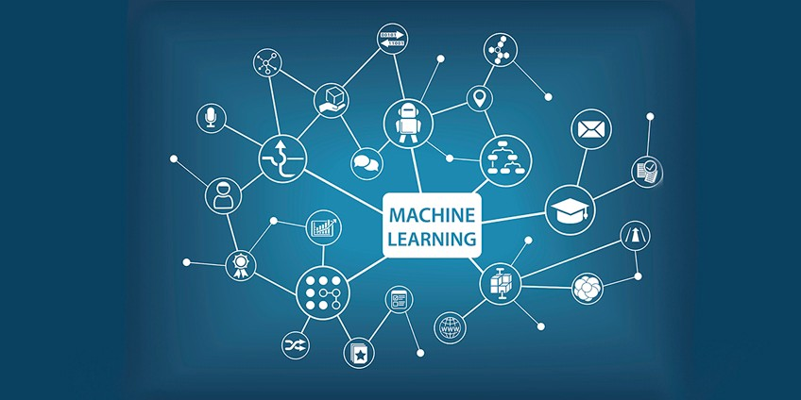
Machine learning :
Machine learning is an application of artificial intelligence (AI) that provides systems the ability to automatically learn and improve from experience without being explicitly programmed. Machine learning focuses on the development of computer programs that can access data and use it learn for themselves.

Slide 12
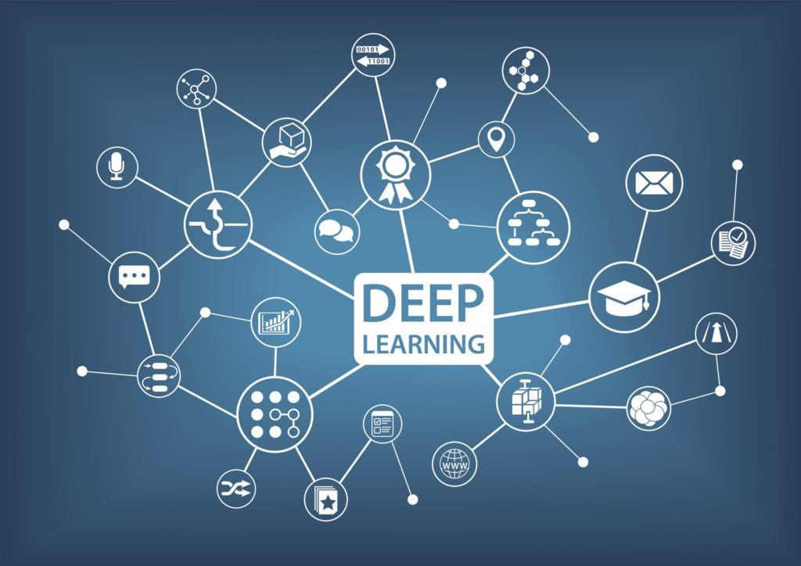
Deep Learning :
Deep Learning is a subfield of machine learning concerned with algorithms inspired by the structure and function of the brain called Artificial Neural Networks.

Slide 13
Research Methodology:
Neural Networks
Artificial Neural Network (ANN)
Convolution Neural Network (CNN)

Slide 14
Artificial Neural Network (ANN) :
An Artificial Neural Network is an information processing model that is inspired by the way biological nervous systems, such as the brain, process information.
They are used for a variety of tasks, a popular use is for classification.
For example : “You can collect datasets of images for example of different breeds of dogs and then train a neural network on the images, then if you supply a new image of a dog it will give a statistical score on how closely the new image matches the model and then will output what breed of dog the image is. ”

Slide 15
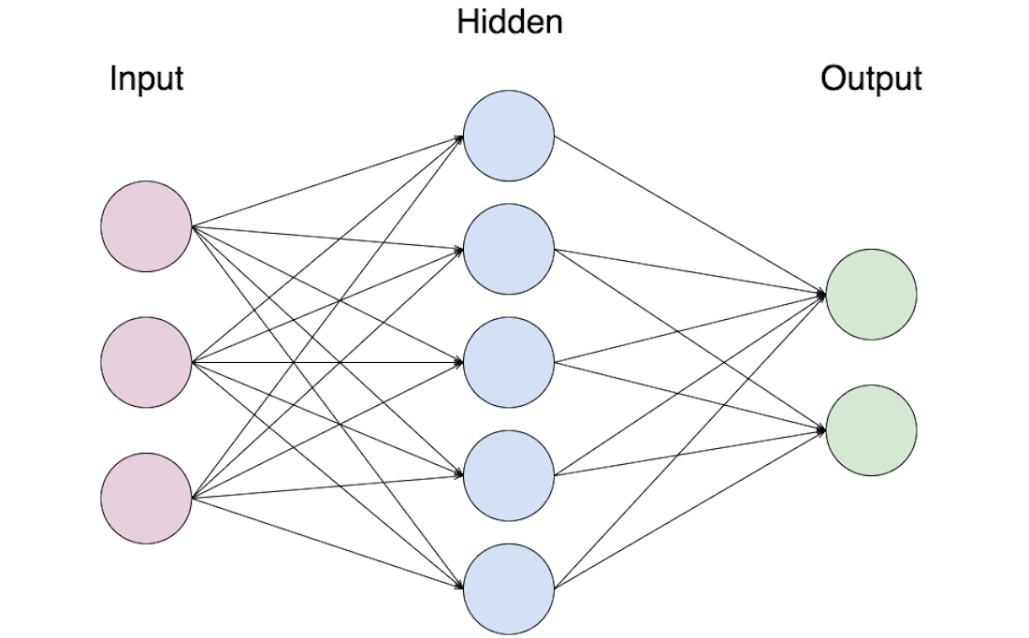
Artificial Neural Network (ANN) :

Slide 16
Convolutional Neural Network :
In neural networks, Convolutional neural network (ConvNets or CNNs) is one of the main categories to do image recognition, images classifications. Object detection, face recognition etc, are some of the areas where CNNs are widely used.
CNN image classifications takes an input image, process it and classify it under certain categories (Eg., Dog, Cat, Tiger, Lion).

Slide 17

Convolutional Neural Network :
Computers sees an input image as array of pixels and it depends on the image resolution. Based on the image resolution, it will see h x w x d( h = Height, w = Width, d = Dimension ). Eg., An image of 6 x 6 x 3 array of matrix of RGB (3 refers to RGB values) and an image of 4 x 4 x 1 array of matrix of grayscale image.

Slide 18
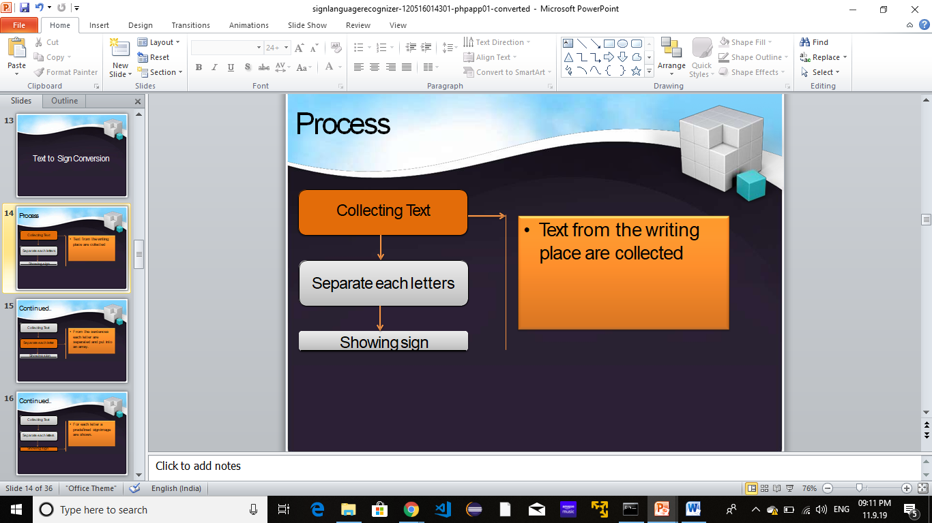
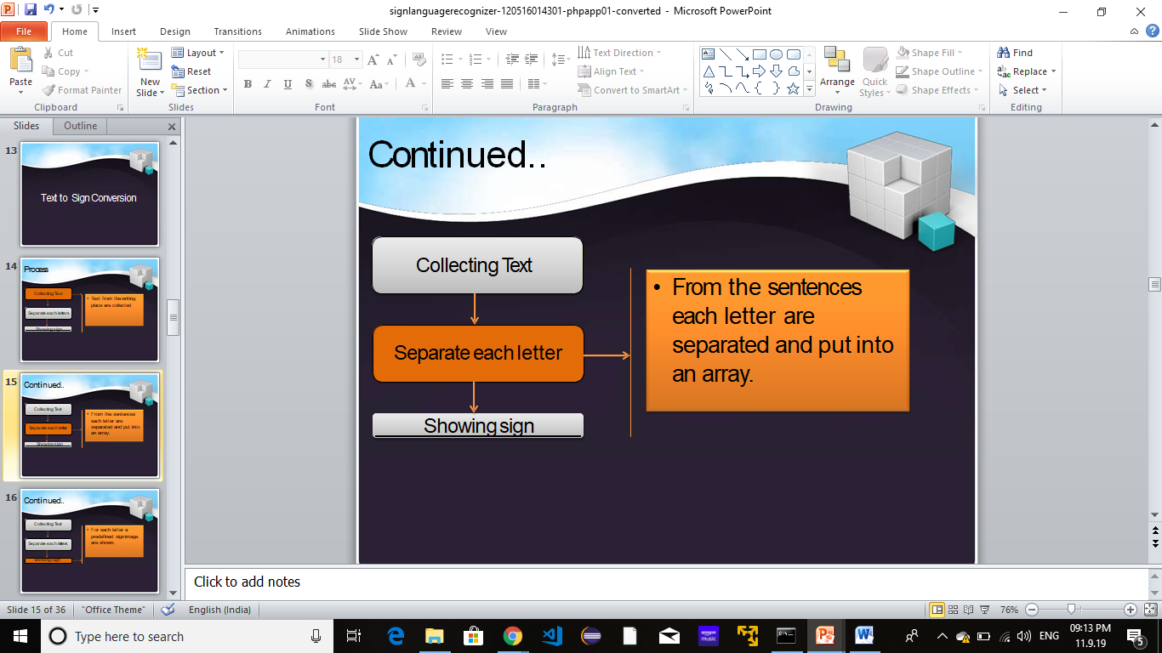
Implementation :
Let’s first understand the process of Sign to Text conversion :
Collecting text
Separate each letter

Slide 19
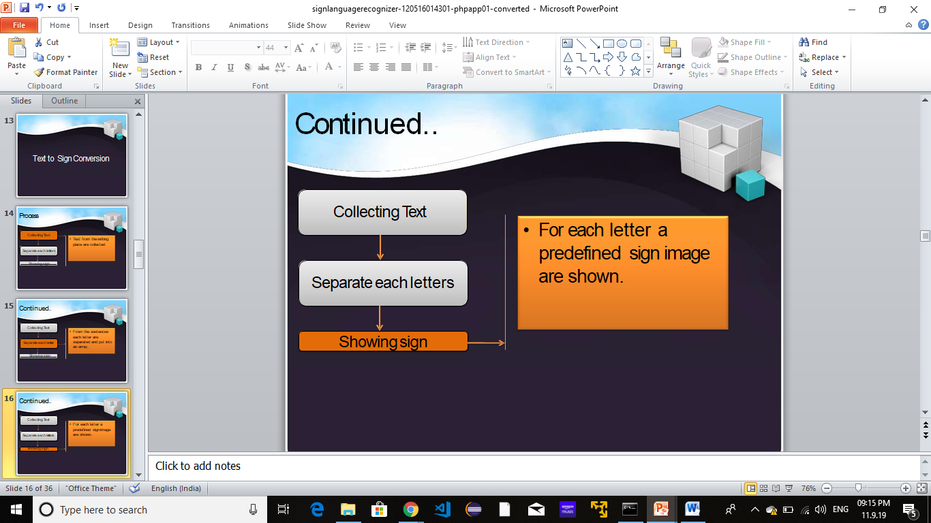
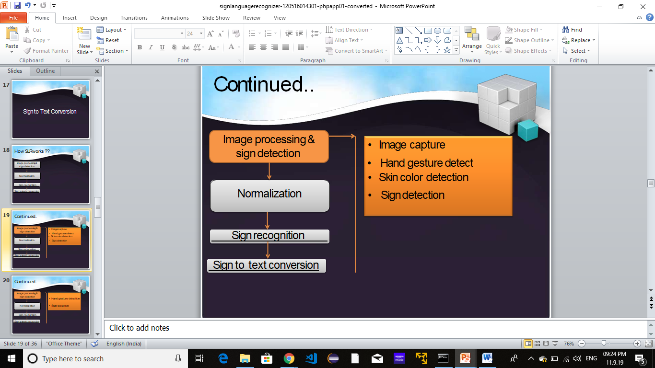
Implementation :
Showing Sign
Image processing & sign detection

Slide 20
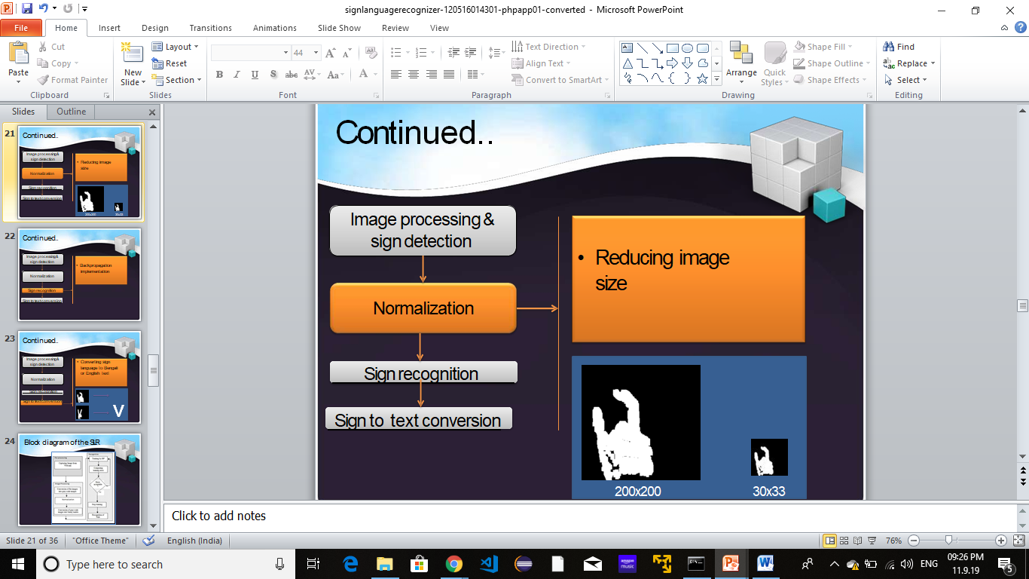
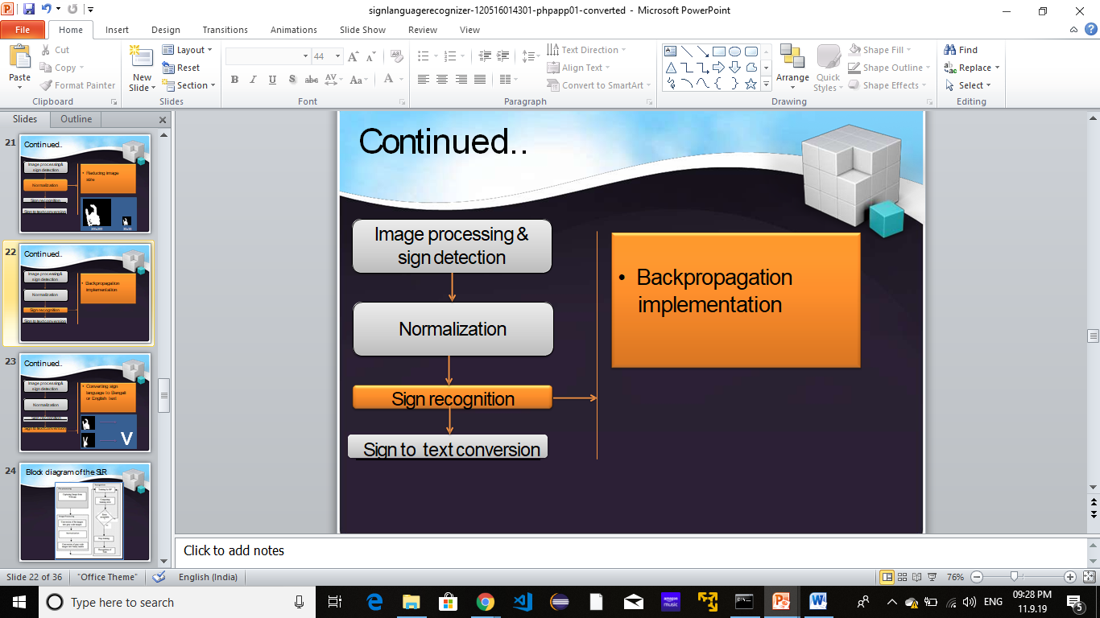
Implementation :
Normalization
Sign Recognition

Slide 21
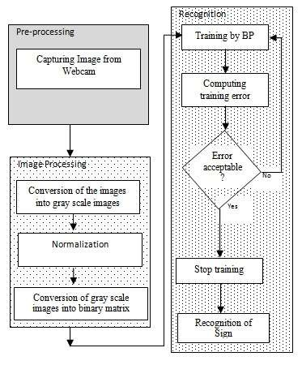
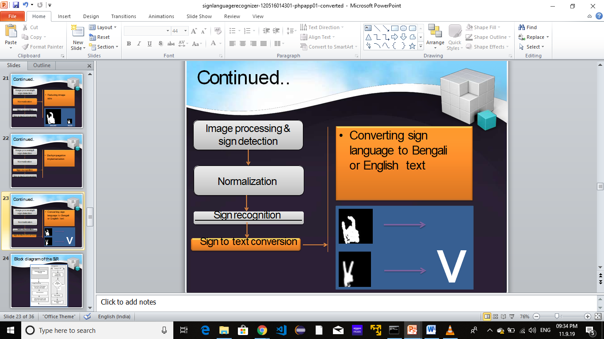
Implementation :
Sign to Text conversion
Block Diagram

Slide 22
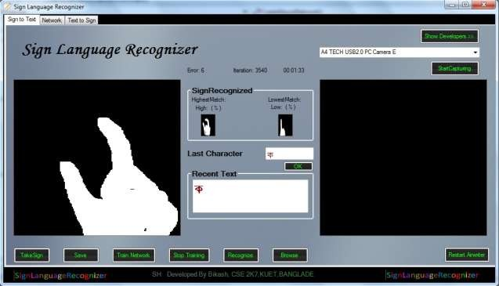
Working Procedure :
SLR capture signs shown by deaf or dumb man
Convert the signs to text
This text is shown to shopkeeper
e shopkeeper can understand the deaf man’s demands

Slide 23
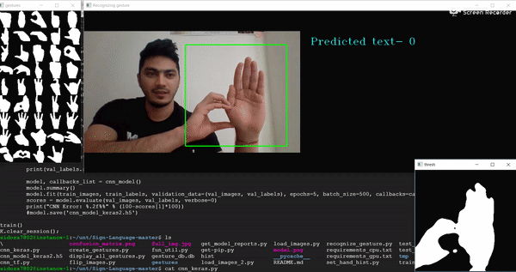
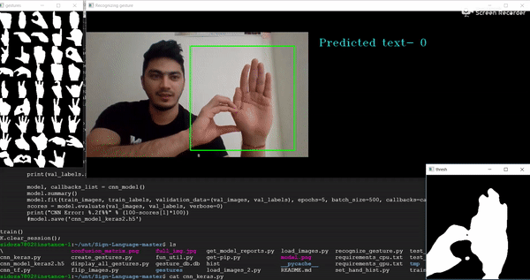
Implementation Video :

Slide 24
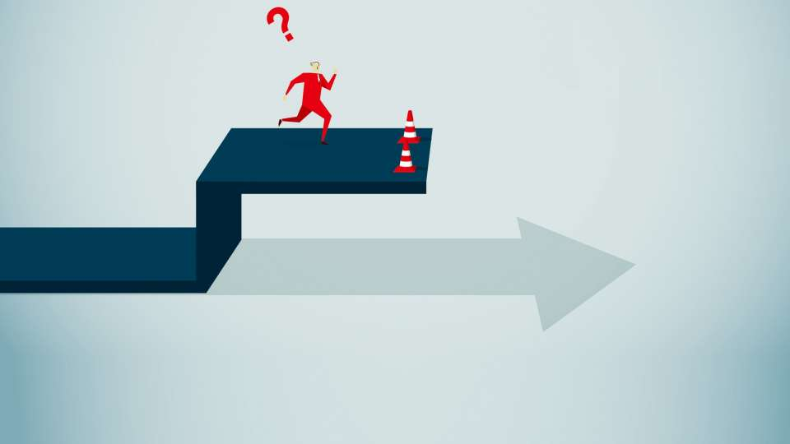
Limitations :
Due to brightness and contrast sometimes webcam can hardly detect the expected skin color.
Because of the similarity of tracking environment background color and skin color the SLR gets unexpected pixels.
Due to almost similar pattern its become hard to take decision.

Slide 25
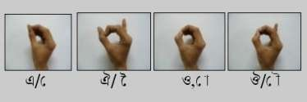
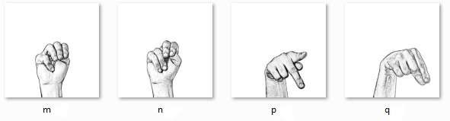
Limitations :
Similar patterns

Slide 26
CONCLUSION
Parameters | ANN | CNN
Loss | 0.0974 | 0.0679
Accuracy | 0.9026 | 0.9869
Val_Loss | 0.0500 | 0.0439
Val_Accuracy | 0.95 | 0.9561
CNN most preferred method for the image processing and especially in the case of the image mining/text mining. Since, ANN has high false acceptance rate (FAR), which reduces its efficiency towards this method.
TABLE 2 ACCURACY AND LOSS OF ANN AND CNN.

Slide 27
References
1. Nikos K. Logothetis, David L. Sheinberg (2012), Visual Object Recognition, Division of Neuroscience, Baylor College of Medicines, One Baylor Plaza, Houston, Texas.
2. J. R. R. Uijlings, K. E. A. van de Sande, T. Gevers, A. W. M. Smeulders (2013). Selective Search for Object Recogntion, Int J Comput Vis.
3. Ching-Hua Chaun, Eric Regna, Caroline Guardino (2014), Univeristy of North Florida, American Sign Language Recognition Using Leap Motion Sensor.
4. Sebestian Jean, Kyunghyun Cho, Roland Memisevic (2015), University of Montreal, On Using Very Large Vocabulary for Neural Machine Translation.
5. Kaiming He Xiangyu, Zhang Shaoqing, Ren Jian Sun, Microsoft Research, Kahe, v-xiangz, v-shren, jiansun, Deep Residual Learning for Image Recognition.
6. Hoo-Chang Shin, Member, IEEE, Holger R. Roth, Mingchen Gao, Le Lu, Senior Member, IEEE, Ziyue Xu, Isabella Nogues, Jianhua Yao, Daniel Mollura, Ronald M. Summers, Deep Convolutional Neural Networks forComputer-Aided Detection: CNN Architectures Dataset Characteristics and Transfer Learning.
7. Jie Huang, Wengang Zhou, Qilin Zhang, Houqiang Li, Weiping Li (2018), Video-Based Sign Language Recognition without Temporal Segmentation, University of Science and Technology, China

Slide 28
Any Questions?

